Slide 1





Introduction to DevOps
The Big Picture. Basic Toolkit
Basic Automation
DevOps
Basics
SoftUni Team
Technical Trainers
Software University
http://softuni.bg

Slide 2

Table of Contents
About this Course
The Big Picture
Main Pain Points and Causes
Goals and Benefits
Adoption and Tools
Basic Toolkit
Basic Automation

Slide 3

About this Course
Content. Delivery. Homework. Exam

Slide 4
Content
Topics
Working with Linux
Virtualization and Containerization
Working with Docker, Ansible, Jenkins, Nagios, and Azure
Combining all the pieces together
Goals
Feel comfortable in Linux environment
Be able to handle basic to intermediate tasks in DevOps world

Slide 5
Infrastructure
Required
CPU with VT-x/AMD-V
8GB+ RAM, 25GB+ HDD
Target virtual infrastructure
Ranging from three to five nodes

Slide 6
Homework and Exam
Homework
No, but you can go over the Class Practice
Exam
One date – 07.01.2018
Practical exam – max 100 pts.

Slide 7
Logistics
Every Wednesday (25.10 – 13.12) at 18:30
Schedule
18:30 – 19:30 Module X-1
19:30 – 19:45 Break
19:45 – 20:45 Module X-2
20:45 – 21:00 Break
21:00 – 22:00 Module X-3

Slide 8
About me
About me
Dimitar Zahariev
During office hours – BI/DI Consultant
openSUSE Advocate and Virtualization Enthusiast
Communication channels
SoftUni Forum
e-mail: dimitar@zahariev.pro
Skype: zahariev.dimitar
sli.do: #SU-DBO-Mx (where x is between 1 and 8)

Slide 9

About you
About you
Go here: https://tinyurl.com/su-dob-in
Few words about you
Your expectations/suggestions

Slide 10
Have a Question?
sli.do
#SU-DOB-M1

Slide 11
Introduction Summary
We are ready to move forward.

Slide 12
The Big Picture
Why we do need a change?

Slide 13
Typical Company Organization
Many departments, and all depend on IT in one way or another
HR
Marketing
IT
Finance
Sales

Slide 14
Typical IT Organization
IT has its own units
Project Managers
Architects
Business Analysts
Developers
Quality Assurance
Operations
Help Desk
Information Security

Slide 15
Typical Challenges
Complex pipeline
Mixed environment
Externally customized software
Custom internal software
Staff is leaving or being moved elsewhere
Absent know-how, outdated or missing documentation
Operations have to maintain black-boxes

Slide 16
Main Pain Points
At least some of them

Slide 17
Outages
Typically in high priority systems
Usually with long recovery time
Panic mode
Lack of expertise
Lost trust

Slide 18
Low value
Slow delivery
Long time to wait before the actual consumption
Long implementation periods
Often the delivery is outdated and doesn’t match the current requirements

Slide 19
Slow IT
In fact is more a perception than a reality
It leads to
Software-as-a-Service solutions
Departmental solutions
It is caused by
Long waiting
Too many restrictions
Poor performance

Slide 20
Fighting
Involved parties
IT vs. Business
Internally in IT
Typically caused by
Lost trust
Absence of transparency
Different motivators or bonus schemes

Slide 21
Causes

Slide 22
Lack of Knowledge
Poor communication
Between the departments
Internally in IT, between roles
Missing documentation
Hard to distinguish between important and unimportant
Too many meetings
Too many and too complex reports

Slide 23
Slow Processes
Sources
Slow provisioning of environments
Next role is waiting for the previous to finish
Approval takes time
Affected parties
Internal
External

Slide 24
Over-something
Over-provisioning
Request more resources than actually needed
Over-production
Ask for features just to keep everyone busy
Over-processing
For example apply unnecessary transformations over and over
Over-delivery
Deliver more than requested

Slide 25
Logistics
Slow delivery of features
Long (time expensive) updates
Repetitive manual testing procedures
Unnecessary iterations
From environment to environment
Delivery in a rush
Do it on time no matter the quality
Postpone a delivery
A ready feature is waiting something else to be shipped first

Slide 26
Goals and Benefits

Slide 27
How can DevOps help?
Add value and flow improvement
Prerequisites
Identify a shared pain
Address the causes
Result
Added value – financial impact

Slide 28
DevOps is Lean for IT
We should not cut costs, but free up resources
This can be achieved by
Focus on customer value
Optimize the process
Reduce delivery time
Shared knowledge
Avoid batching
Address bottlenecks

Slide 29
Core Values* of DevOps Movement
Culture
Break down barriers between teams, safe environment
Automation
Save time, prevent defects, create consistency, self-service
Measurement
If you can not measure it, you can not improve it
Sharing
Sharing the tools, discoveries, and lessons
* Damon Edwards and John Willis

Slide 30
Adoption
Making the Transition

Slide 31
Change Culture
Question to identify the Shared Objective
Authorization for Action
Responsibility for Actions
(Cross-) Teamwork
Learning and Sharing even from Mistakes
Trust (between parties)
Values and Rewards (who, why, how)

Slide 32
Change Organization (understand & asses)
Understand the processes
All components - systems, people, value, etc.
Achieve clear vision
Asses and acknowledge bottlenecks
Inconsistent environments
Manual and custom builds
Poor quality
No communication

Slide 33
Change Organization (change & improve)
Change team structure
Concentrated knowledge or many tasks assigned to one person
Generalists vs Specialists
Complete (or consistent) team
Prepare handoff (think about the next step)
Self assessment (assess processes)
Clean-up (remove extra steps, components, …)

Slide 34
Objections
Security (developers on production, security issues)
Communication, Upfront quality, Proper testing, Ship quickly
Compliance (restricted access, all-or-nothing)
Better control - who, what, where
Remote teams (internal teams or external parties)
Shared objectives, Technology solutions, Renegotiation
Impact on employees
Presence of legacy systems
Lack of appropriate skills (technical and soft skills)

Slide 35
The Three Ways
Principles behind DevOps
Gene Kim, “The Three Ways: The Principles Underpinning DevOps”

Slide 36
The First Way
Visible work, short batch size and intervals of work, build in quality, constant optimization
Dev
Ops

Slide 37
The Second Way
Fast and constant flow of feedback from right to left
Amplify feedback to prevent problems from reoccurring. Enable faster detection and recovery
Dev
Ops

Slide 38
The Third Way
Culture of continual experimentation and learning
Continual experimentation, taking risks and learning from failure
Repetition and practice is the prerequisite to mastery
Dev
Ops

Slide 39
Mentality and Tools

Slide 40
Mentality
If it isn’t broke, don’t fix it
Continuous Improvement

Slide 41
Tools
Collaboration (connect)
Planning (transparency)
Issue tracking (feedback)
Monitoring (measurement)
Configuration management (consistency)
Source control (control code & configuration)
Continuous integration
Deployment

Slide 42
Virtualization
Fundamental Principles and Use Cases

Slide 43
What is Virtualization?
Virtualization is the act of creating a software-based or virtual (rather than physical) version of something
Main definitions
Host OS (machine)
Virtual machine
Guest OS (machine)
Guest additions
VM
VM
Guest OS
(machine)
Guest OS
(machine)
Additions
Additions
Host OS
(machine)

Slide 44
Hypervisors
A hypervisor or virtual machine monitor (VMM) is computer software, firmware, or hardware, that creates and runs virtual machines
VM
VM
Guest OS
Guest OS
VM
VM
Guest OS
Guest OS
Additions
Additions
Additions
Additions
Hypervisor
Hypervisor
Host OS
Hardware
Hardware
Type 1 (bare metal)
Type 2 (hosted)

Slide 45
Use Cases
Infrastructure consolidation
Better usage and utilization of the available hardware
Maintain separate environments
For example – development, test, production
Testing and evaluation
Test a newer software version or evaluate a product
High availability and disaster recovery

Slide 46
Our Case
We would like to
Install multiple machines on limited hardware resources
Manage their isolation
Manage their state – our own time-machine
Move, export, and import them
Clone them – create multiple copies out of one master
The answer is Virtualization

Slide 47
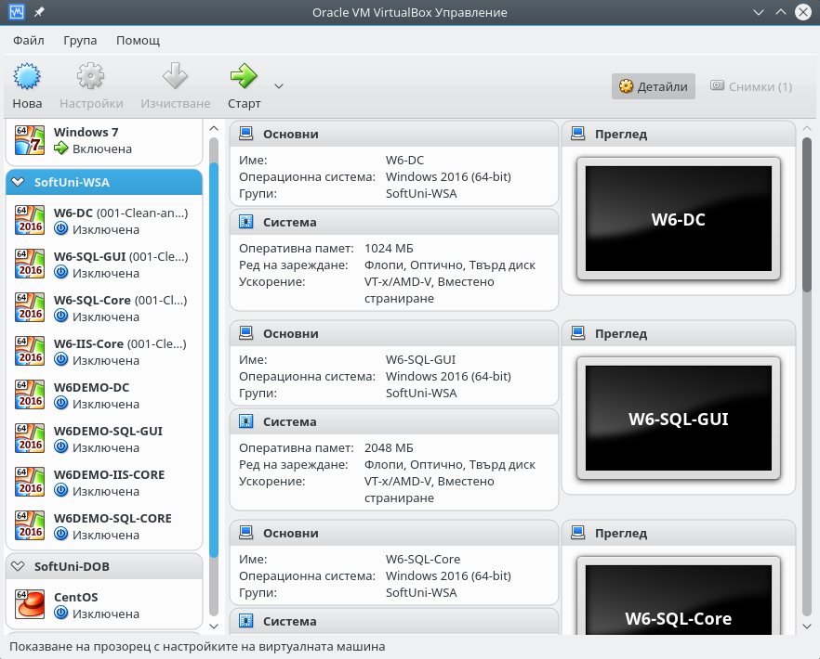
VirtualBox
Cross-platform
Broad guest OS support
Easy to install
Simple GUI
Automation options
Free

Slide 48
Containerization
Fundamental Principles and Use Cases

Slide 49
What is Containerization?
It involves encapsulating an application in a container with its own operating environment
Containers are
Lightweight
Stand-alone
Executable packages
Container
Container
App A
App B
Bin/Libs
Bin/Libs
Containerization Platform
Host OS
(machine)

Slide 50
Containerization vs. Virtualization
Similar resource isolation and allocation benefits
Containers virtualize the operating system not the hardware. That is why they are more portable and efficient
VM
VM
Container
Container
App A
App B
App A
App A
Bin/Libs
Bin/Libs
Bin/Libs
Bin/Libs
Guest OS
Guest OS
Containerization Platform
Hypervisor
Host OS
Host OS
Hardware
Hardware
Containerization
Virtualization

Slide 51
Linux
Architecture. Distributions. Console

Slide 52
Why Linux?
It is a phenomenon
Went all the way from a student’s hobby to world domination
Internet runs on Linux
Operating system for over 95% of the top one million domains *
It runs on 99.6% of the top 500 supercomputers **
There is huge demand for Linux skills
It is both challenging and fun
* https://www.linuxfoundation.org/about
** https://itsfoss.com/linux-99-percent-top-500-supercomputers/

Slide 53
What is (not) Linux?
It is NOT the complete OS, it is just the Kernel
Often the term is used to refer to the whole OS
A Linux-based system is a modular Unix-like operating system
Linux kernel is a monolithic kernel

Slide 54
What we need to know?
General knowledge about Linux
Working with users, groups, and permissions
Working with files and folders
Handling some basic network related tasks
Software and services management
Basic bash scripting skills

Slide 55
Bash Scripting
Structure. Flow Control. Sourcing. Execution

Slide 56
Structure
Script Signature
#!/bin/bash
#
# hello.sh
#
attn = "dear"
echo "Hello $attn $USER"
Execution: bash hello.sh or ./hello.sh or just hello.sh
Comments
Local Variable
Command

Slide 57
echo
Description
Display line of text
Example
[user@host ~]$ echo 'Hello world!‘
'Hello world!'
[user@host ~]$
...

Slide 58
read
Description
Read a line from the standard input and split it into fields
Example
[user@host ~]$ read -p "Enter name:" NM_ENT
Enter name: James
[user@host ~]$ echo $NM_ENT
James

Slide 59
if
Description
Execute commands based on conditional
Example
count=1
if [ $count -eq 0 ]; then
echo 'Equal to 0'
else
echo 'Not equal to 0'
fi

Slide 60
test
Description
Evaluate conditional expression
Example
# Compare numbers: OP1 -eq|-ne|-lt|-le|-gt|-ge OP2
# Compare strings: ST1 =|!=|<|> ST2
# Compare files: FL1 -nt|-ot FL2
# File tests: -d|-e|-f|-x FILE

Slide 61
for
Description
Execute command for each member in a list
Example
# List all files with prefix “item:”
for i in $( ls ); do
echo item: $i
done

Slide 62
while
Description
Execute commands as long as a test succeeds
Example
# Print numbers from 1 to 5
count=1
while [ $count -le 5 ]; do
echo $count
count=$((count+1))
done

Slide 63
until
Description
Execute commands as long as a test does not succeed
Example
# Print numbers from 1 to 5
count=1
until [ $count -gt 5 ]; do
echo $count
count=$((count+1))
done

Slide 64
Sourcing vs. Execution
Sourcing
No subshell is created
Any variables set become part of the environment
Methods: . script.sh or source script.sh
Execution
Subshell is always created
No subshell if using exec ./script.sh

Slide 65
Source Control
Git. Files Lifecycle. Basic Commands

Slide 66
General Information
Distributed Version Control
Created by the Linux development community in 2005
Can be used on-premise and in the cloud
Snapshot based
Three states - Committed, Modified, and Staged

Slide 67
Files Lifecycle
Not Tracked
(outside the scope)
Staged
(about to be committed)
Modified
(changed)
Committed
(not modified)
Add the file
Commit
Edit the file
Stage the file
Remove the file

Slide 68
Basic Git Commands
Create an empty Git repository
Clone an existing repository
Show repository objects
Show different states of files in working directory and staging
git init
git clone https://github.com/user/repo
git show
git status

Slide 69
Basic Git Commands
Add files from working directory to staging
Remove a file from staging and working directory
Move or rename file
Commit the staged changes
git add file.txt
git rm old_file.txt
git mv old_file.txt new_file.txt
git commit

Slide 70
Basic Git Commands
Get all not existing objects from remote repository
Get and merge changed objects from remote repository
Push the changes to a remote repository
git fetch https://github.com/user/repo
git pull
git push

Slide 71
Practice: Non-automated Way
Live Demonstration in Class

Slide 72
Vagrant
Introduction. Basic Commands

Slide 73
Introduction
Building and managing virtual machine environments
Providers like VirtualBox, VMware, AWS, etc.
Provisioning tools such as shell scripts, Chef, or Puppet
Multiplatform
Integration with source control systems
Public boxes catalog: https://atlas.hashicorp.com/boxes/search
Local storage for boxes: ~/.vagrant.d/boxes

Slide 74
Vagrant file
Ruby syntax
One file per environment
General file structure
# -*- mode: ruby -*-
# vi: set ft=ruby :
...
Vagrant.configure("2") do |config|
config.vm.box = "shekeriev/centos-7-32-minimal“
...
end

Slide 75
Vagrant file
Vagrant.configure("2") do |config|
config.vm.box = "shekeriev/centos-7-32-minimal”
# Provider settings
config.vm.provider "virtualbox" do |vb|
# Display the VirtualBox GUI when booting the machine
vb.gui = true
# Customize the amount of memory on the VM:
vb.memory = "1024"
end
# Provisioning section
config.vm.provision "shell", inline: <<-SHELL
yum -y update
yum install -y httpd
SHELL
end

Slide 76
Basic Vagrant Commands
Initialize the environment
Login to HashiCorp’s Atlas
Connect to machine via SSH
Check status of a vagrant machine
vagrant init [options] [box]
vagrant login
vagrant ssh [options] [name|id]
vagrant status [name|id]

Slide 77
Basic Vagrant Commands
Start and provision grant environment
Stop a vagrant machine
Stop and delete vagrant machine
Manage boxes
vagrant up [options] [name|id]
vagrant halt [options] [name|id]
vagrant destroy [options] [name|id]
vagrant box <subcommand> [<arguments>]

Slide 78
Practice: Vagrant in Action
Live Demonstration in Class

Slide 79
Resources
Vagrant site
https://www.vagrantup.com
Vagrant boxes repository (Vagrant Cloud)
https://app.vagrantup.com/boxes/search
CentOS download
https://www.vagrantup.com/
CentOS (Red Hat) documentation
https://access.redhat.com/documentation/en/red-hat-enterprise-linux/

Slide 80
Summary
DevOps
Is for companies of any size
Adds value and flow improvement
DevOps is a combination of
Cultural changes
Organizational changes
Tools
We are not alone – there is a toolkit to help us
Vagrant allows us to automate infrastructure life-cycle

Slide 81







Introduction to DevOps
https://softuni.bg/courses/

Slide 82





Trainings @ Software University (SoftUni)
Software University – High-Quality Education, Profession and Job for Software Developers
softuni.bg
Software University Foundation
http://softuni.foundation/
Software University @ Facebook
facebook.com/SoftwareUniversity
Software University Forums
forum.softuni.bg

